Slide 1

Communication Honor Society
Lambda Pi Eta (LPH) is the National Communication Association’s official honor society at universities nationwide. The honor society recognizes outstanding student scholars in Communication

Slide 2
Apply for membership in CSU’s Mu Sigma Chapter of Lambda Pi Eta
To be eligible for individual Student Membership, a student must:
Have completed 60 semester credit hours
Have a minimum overall cumulative GPA of 3.0
Have completed the equivalent of 12 semester credit hours in Communication Studies
Have a minimum GPA of 3.25 for all Communication Studies courses
Currently be enrolled as a student in good standing, as determined by CSU
Apply by Friday, April 3rd, 5:00 pm for Spring 2026 Induction.
To apply, Contact Dr. K. Sabbath [Karyl.sabbath@colostate.edu] or refer to the Communication Studies Webpage. https://communicationstudies.colostate.edu/undergraduate-program/expanded-classroom/#lambda

Slide 3
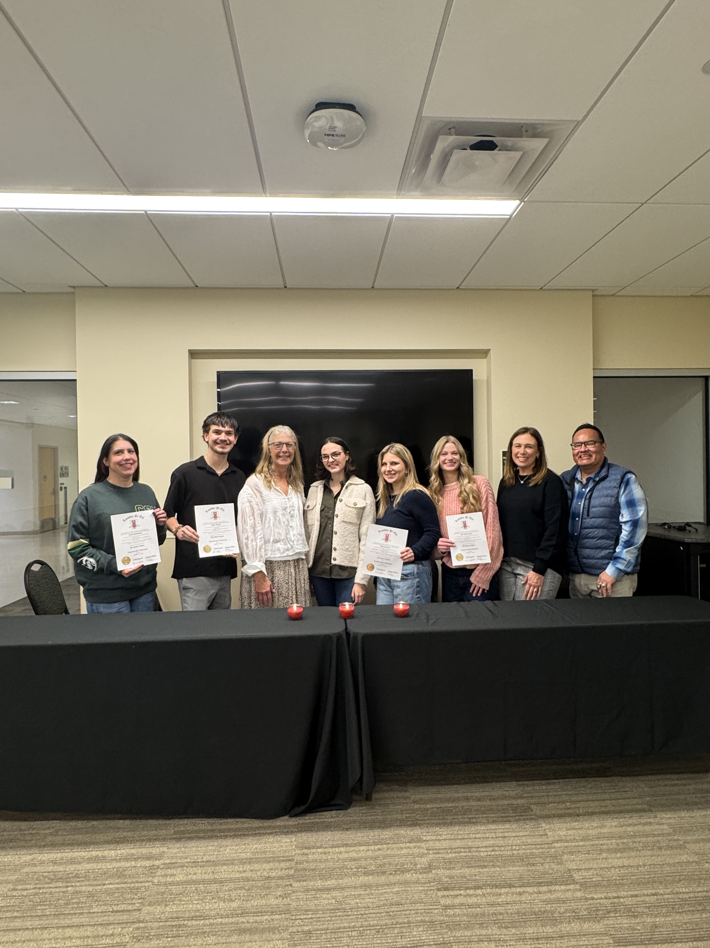
Fall 2025 Induction Class CSU’s Department of Communication Studies Mu Sigma Chapter of the National Communication Association’s (NCA) undergraduate honor society, Lambda Pi Eta.

Slide 4
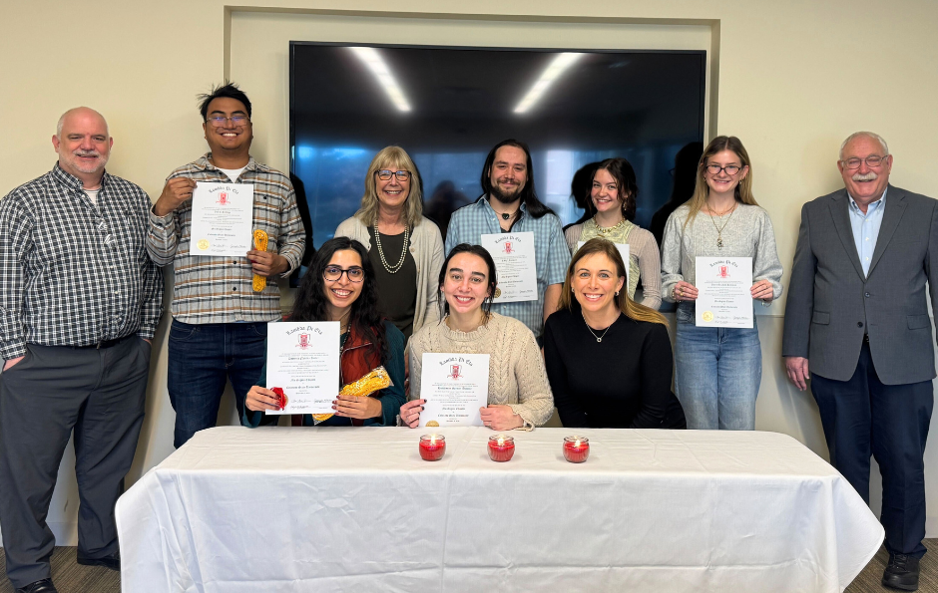
Fall 2024 Induction Class CSU’s Department of Communication Studies Mu Sigma Chapter of the National Communication Association’s (NCA) undergraduate honor society, Lambda Pi Eta.

Slide 5
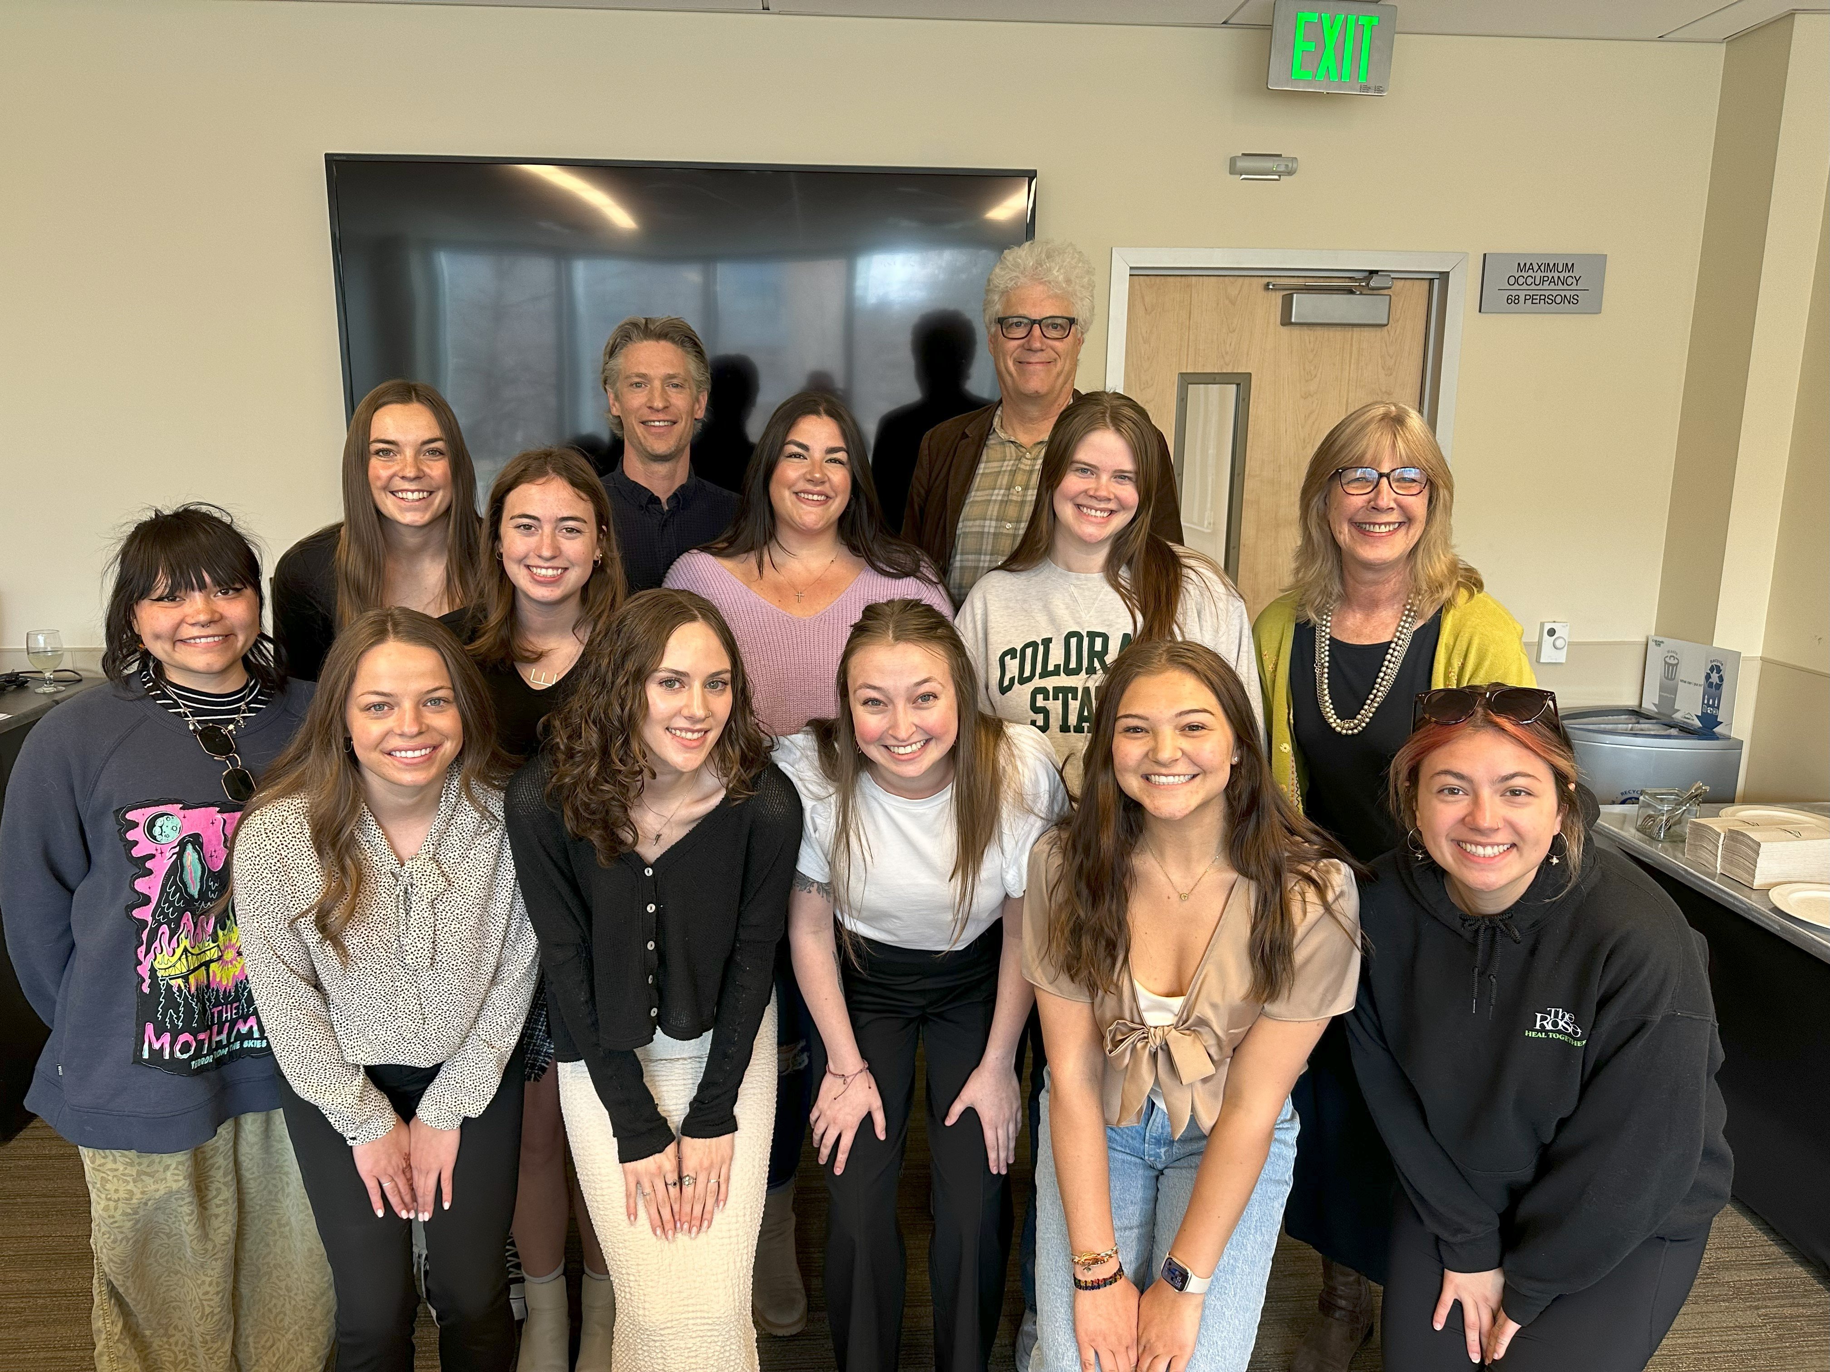
Spring 2023 Induction Class CSU’s Department of Communication Studies Mu Sigma Chapter of the National Communication Association’s (NCA) undergraduate honor society, Lambda Pi Eta.

